Slide 1

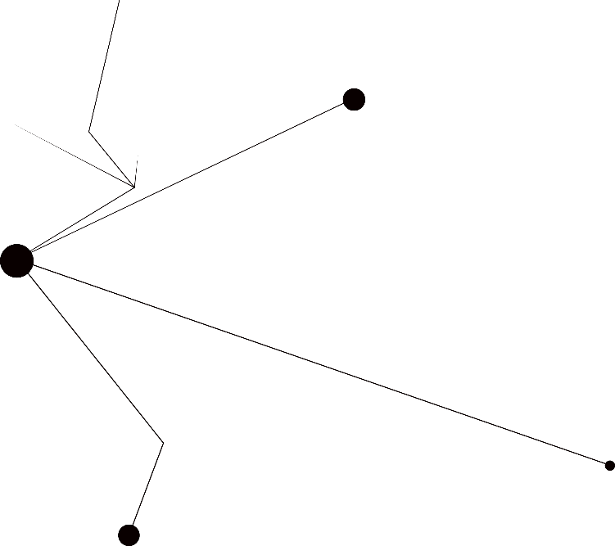
Aicar
第二次展示
第三组
范卓娅、张雅坤、
宋锐、黎春颖、孙佳佳

Slide 2


PART 01
小白鸽
小白鸽

Slide 3

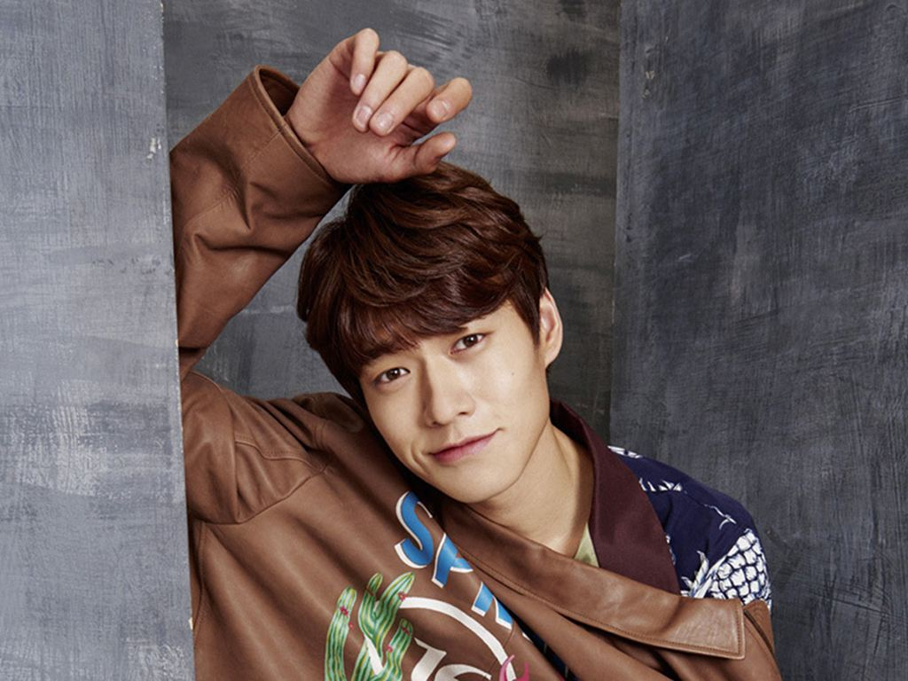
白敬亭
01
小白鸽
B J T
魏大勋
W D X

Slide 4
01
小白鸽
IDENTIFY FACES I
HOG / CNN
DETECT FACES
HAAR cascades
人脸特征分类器
IDENTIFY FACES II
HOG / CNN

Slide 5
### 循环 ###
while True:
suc, frame = vs.read()
if not suc:
break
# 构建分离器
frame = imutils.resize(frame, width=750)
gray = cv2.cvtColor(frame, cv2.COLOR_BGR2GRAY)
faceCascade = cv2.CascadeClassifier(cascPath)
# 检测人脸
faces = faceCascade.detectMultiScale(
gray,
scaleFactor=1.1,
minNeighbors=10,
minSize=(30, 30),
flags=cv2.CASCADE_SCALE_IMAGE
#正常比例检测
)
01
小白鸽
DETECT FACES
### 初始化 ###
import cv2
import imutils
import serial.tools.list_ports
plist = list(serial.tools.list_ports.comports())
ser = serial.Serial('COM4', 9600)
vs = cv2.VideoCapture(0)
vs.open('http://172.20.10.8:8080/video')
cascPath = "haarcascade_frontalface_default.xml"
Notes:
vector& objects：输出的矩形向量组
scaleFactor=1.1：这个是每次缩小图像的比例，默认是1.1
minNeighbors：匹配成功所需要的周围矩形框的数目，每一个特征匹配到的区域都是一个矩形框，只有多个矩形框同时存在的时候，才认为是匹配成功，比如人脸，这个默认值是3
minObjectSize maxObjectSize：匹配物体的大小范围
CASCADE_SCALE_IMAGE 正常比例检测

Slide 6
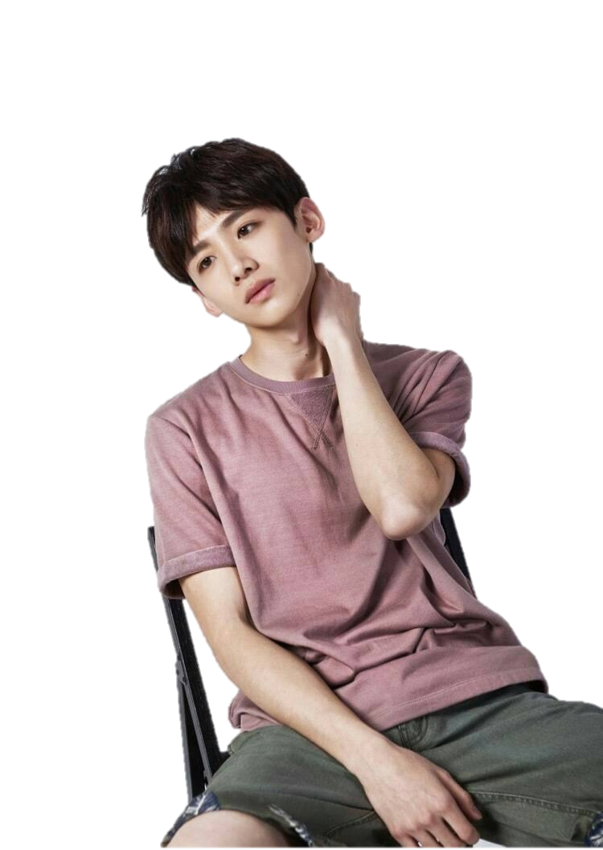
01
小白鸽
……..( while True循环内)
if len(faces):
for (left, top, width, height) in faces:
cv2.rectangle(frame, (left, top),
(left+width, height+top), (0, 255, 0), 2)
ser.write('f'.encode())
else:
ser.write('s'.encode())
cv2.imshow('monitor', frame)
# waitKey()不断刷新图像，频率时间为delay，单位为ms。
key = cv2.waitKey(1000) & 0xFF
if key == 27:
break
ser.write('s'.encode())
cv2.destroyAllWindows()
DETECT FACES

Slide 7
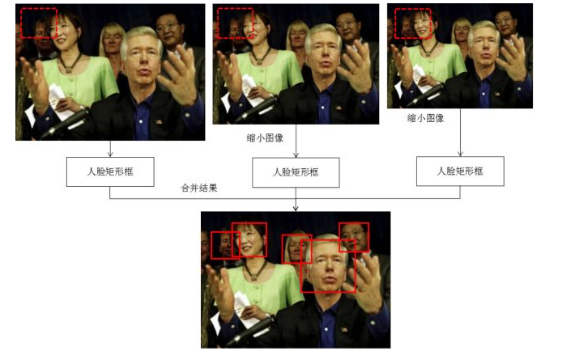
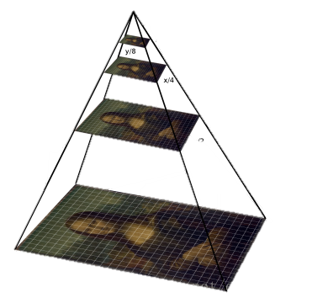
CascadeClassifier原理
01
小白鸽
Notes:
https://blog.csdn.net/qq_37791134/article/details/80583726
由于人脸可能出现在图像的任何位置，在检测时用固定大小的窗口对图像从上到下、从左到右扫描，判断窗口里的子图像是否为人脸，这称为滑动窗口技术（sliding window）。为了检测不同大小的人脸，还需要对图像进行放大或者缩小构造图像金字塔，对每张缩放后的图像都用上面的方法进行扫描。由于采用了滑动窗口扫描技术，并且要对图像进行反复缩放然后扫描，因此整个检测过程会非常耗时。

Slide 8
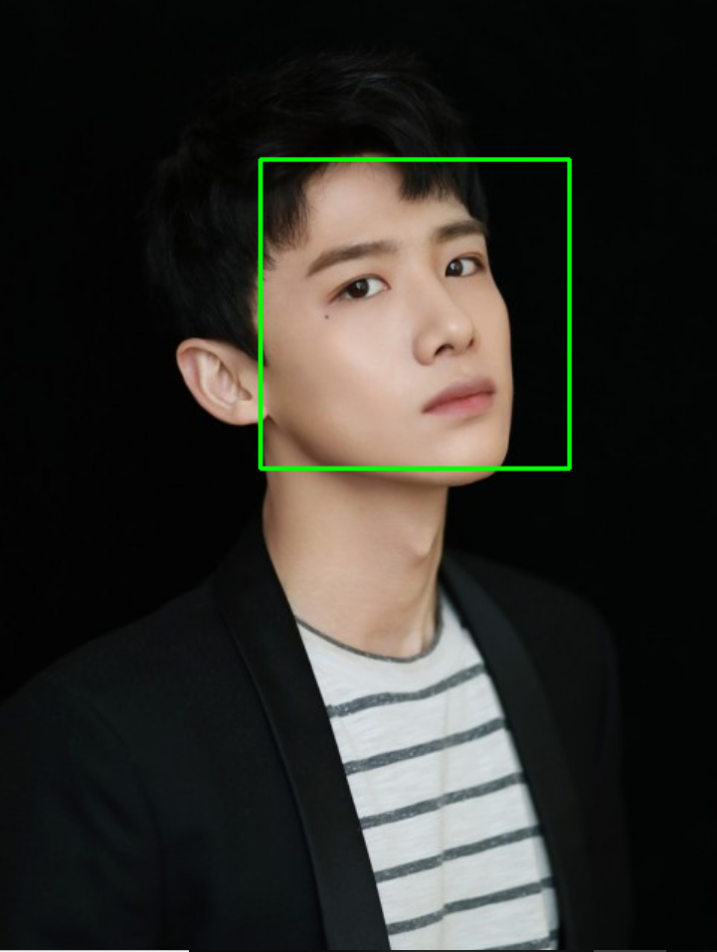
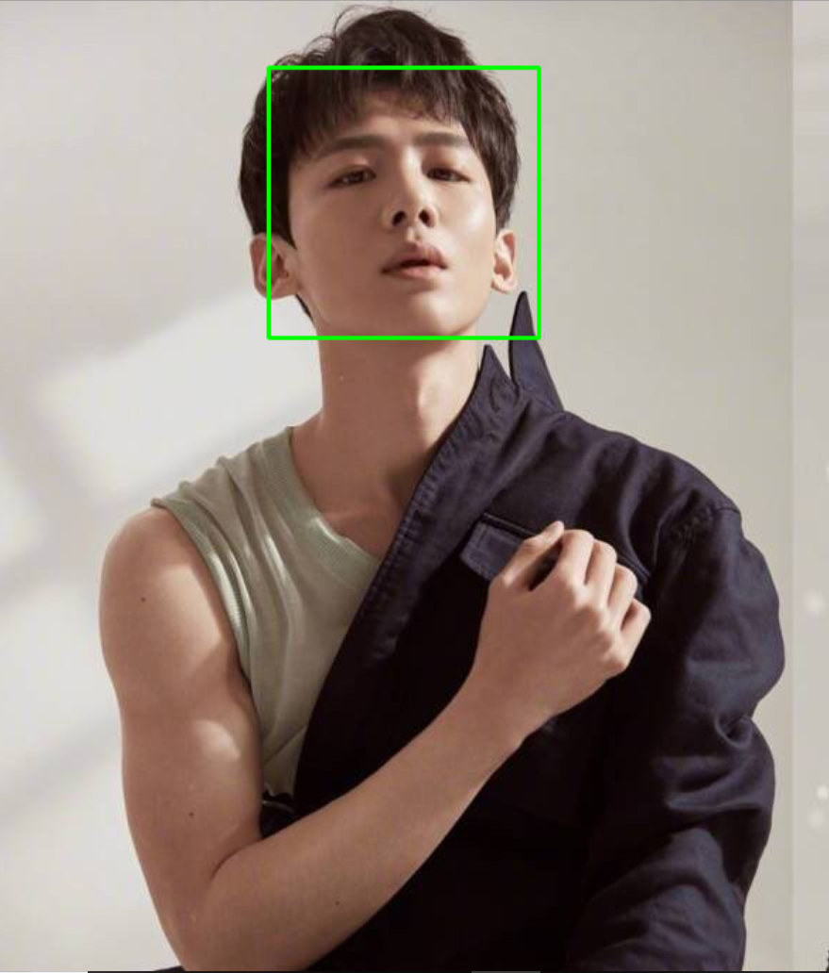
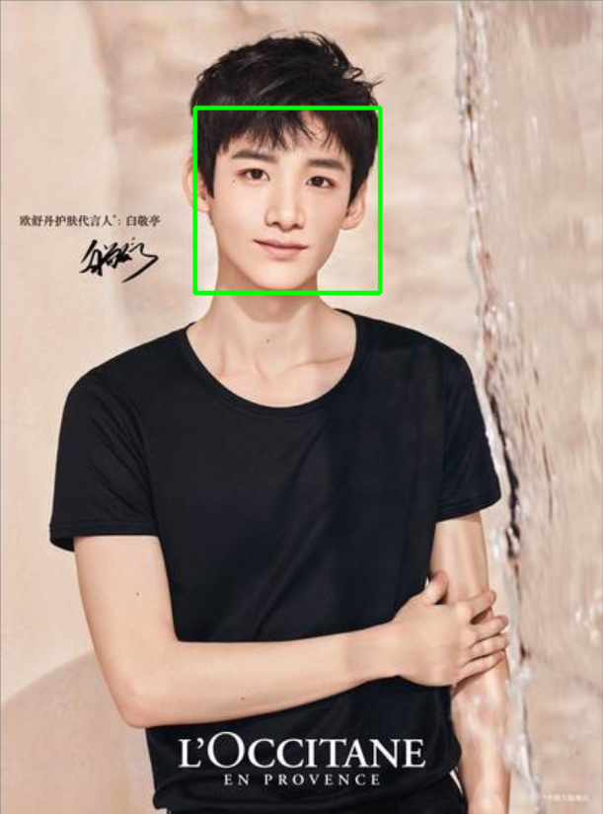
01
小白鸽

Slide 9
01
小白鸽
from imutils import paths
import face_recognition
import argparse
import pickle
import cv2
import os
for (i, imagePath) in enumerate(imagePaths):
name = imagePath.split(os.path.sep)[-2] # os.path.sep是路径分隔符
image = cv2.imread(imagePath)
rgb = cv2.cvtColor(image, cv2.COLOR_BGR2RGB)
IDENTIFY FACES
Encoding faces
Recognizing faces
--Image
--Video
Input:
--dataset
--encodings
--detection_method

Slide 10
01
小白鸽
# 获取脸部位置，返回坐标集合(top, right, bottom, left)
boxes = face_recognition.face_locations(rgb, model=args["detection_method"])
# 计算脸部特征
encodings = face_recognition.face_encodings(rgb, boxes)
for encoding in encodings:
knownEncodings.append(encoding)
knownNames.append(name)
data = {"encodings": knownEncodings, "names": knownNames}
f = open(args["encodings"], "wb")
f.write(pickle.dumps(data))
IDENTIFY FACES
Encoding faces
Recognizing faces
--Image
--Video
Input:
--dataset
--encodings
--detection_method

Slide 11
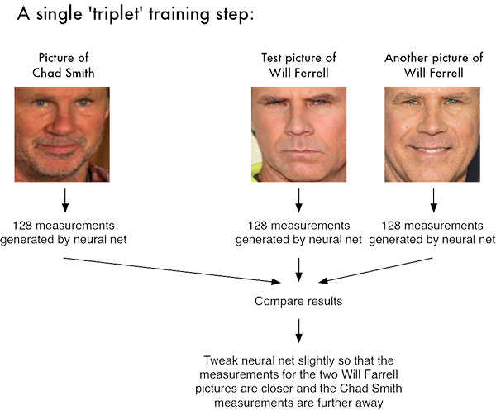
01
小白鸽
Face Recognition原理
IDENTIFY FACES
Encoding faces
Recognizing faces
--Image
--Video
Input:
--dataset
--encodings
--detection_method
Notes:
这个神经网络是dlib的创造者根据三百万张照片训练出来的

Slide 12
01
小白鸽
from imutils import paths
import face_recognition
import argparse
import pickle
import cv2
import os
data = pickle.loads(open(args["encodings"], "rb").read())
image = cv2.imread(args["image"])
rgb = cv2.cvtColor(image, cv2.COLOR_BGR2RGB)
boxes = face_recognition.face_locations(rgb,model=args["detection_method"])
for box in boxes:
(top, right, bottom, left) = box
if abs(top - bottom) <= 50 or abs(right - left) <= 50:
boxes.remove(box)
encodings = face_recognition.face_encodings(rgb, boxes)
IDENTIFY FACES
Encoding faces
Recognizing faces
--Image
--Video
Input:
--encodings
--image
--detection_method

Slide 13
for encoding in encodings:
matches = face_recognition.compare_faces(data["encodings"], encoding)
name = "Unknown"
if True in matches:
matchedIdxs = [i for (i, b) in enumerate(matches) if b]
for i in matchedIdxs:
name = data["names"][i]
counts[name] = counts.get(name, 0) + 1
if max(counts.values()) >= 35:
name = max(counts, key=counts.get)
names.append(name)
for ((top, right, bottom, left), name) in zip(boxes, names):
cv2.rectangle(image, (left, top), (right, bottom), (0, 0, 255), 2)
y = top - 15 if top - 15 > 15 else top + 15
cv2.putText(image, name, (left, y), cv2.FONT_HERSHEY_SIMPLEX,
0.75, (0, 0, 255), 2)
cv2.imshow("Image", image)
cv2.waitKey(0)
01
小白鸽
IDENTIFY FACES
Encoding faces
Recognizing faces
--Image
--Video
Input:
--encodings
--image
--detection_method

Slide 14
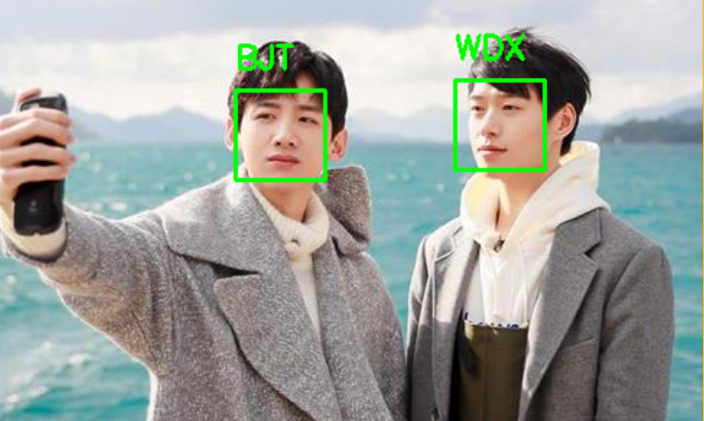
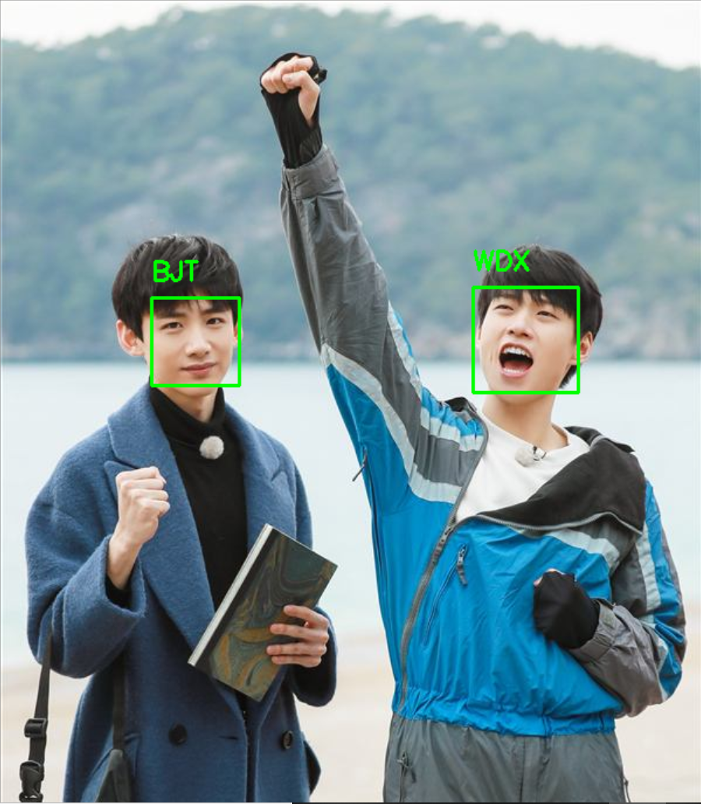
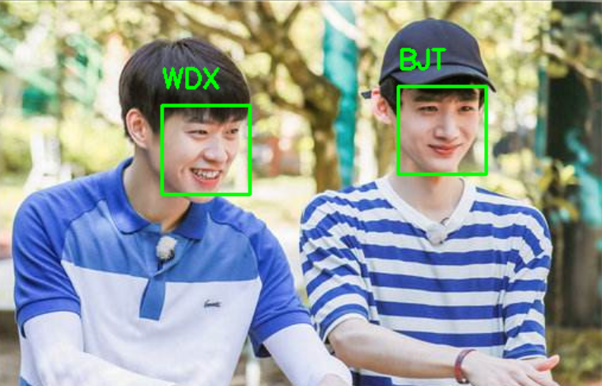
01
小白鸽

Slide 15
data = pickle.loads(open(args["encodings"], "rb“).read())
vs = cv2.VideoCapture(0)
vs.open('http://172.20.10.8:8080/video ‘)
while True:
suc, frame = vs.read()
……. (与处理图像的代码内容相同)
for (i, encoding) in enumerate(encodings):
(top, right, bottom, left) = boxes[i]
……. (与处理图像的代码内容相同)
if max(counts.values()) >= 35:
name = max(counts, key=counts.get)
if name == 'BJT':
if left > 480: # turn left
ser.write('l'.encode())
elif left < 230: # turn right
ser.write('r'.encode())
else: # keep going
ser.write('f'.encode())
else:
ser.write('s'.encode())
else:
ser.write('s'.encode())
01
小白鸽
IDENTIFY FACES
Encoding faces
Recognizing faces
--Image
--Video
Input:
--encodings
--output
--display
--detection_method

Slide 16
01
小白鸽
for ((top, right, bottom, left), name) in zip(boxes, names):
cv2.rectangle(frame, (left, top), (right, bottom), (0, 255, 0), 2)
y = top - 15 if top - 15 > 15 else top + 15
cv2.putText(frame, name, (left, y), cv2.FONT_HERSHEY_SIMPLEX,
0.75, (0, 255, 0), 2)
cv2.imshow('monitor', frame)
key = cv2.waitKey(1) & 0xFF
if key == 27:
break
ser.write('s'.encode())
cv2.destroyAllWindows()
IDENTIFY FACES
Encoding faces
Recognizing faces
--Image
--Video
Input:
--encodings
--output
--display
--detection_method

Slide 17
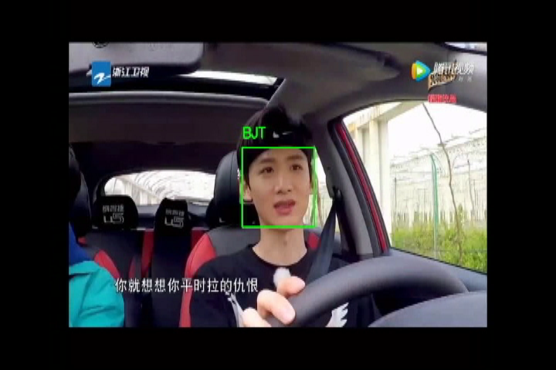
01
TITLE GOES HERE

Slide 18
01
小白鸽
DETECT FACES
IDENTIFY FACES
POSITIVE
NEGATIVE
POSITIVE
NEGATIVE
104 | 117
3 | 16
119 | 16
84 | 1
TRUE
TRUE
FALSE
FALSE
ACCURACY = 221 / 240 = 0.921
PRECISION = 104 / 107 = 0.972
RECALL = 104 / 120 = 0.867
ACCURACY = 135 / 240= 0.563
PRECISION = 119 / 203 = 0.586
RECALL = 119 / 120 = 0.992
Notes:
辨别两个人人脸的准确率90%以上
P 精确率
Acc准确率

Slide 19
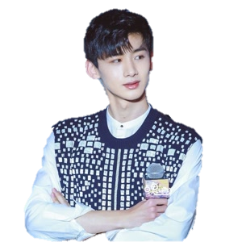
01
小白鸽
问题:
1.精确度、准确度低
2.人脸识别算法慢
3.侧脸和闭眼难以识别
4.图片清晰度影响识别结果

Slide 20

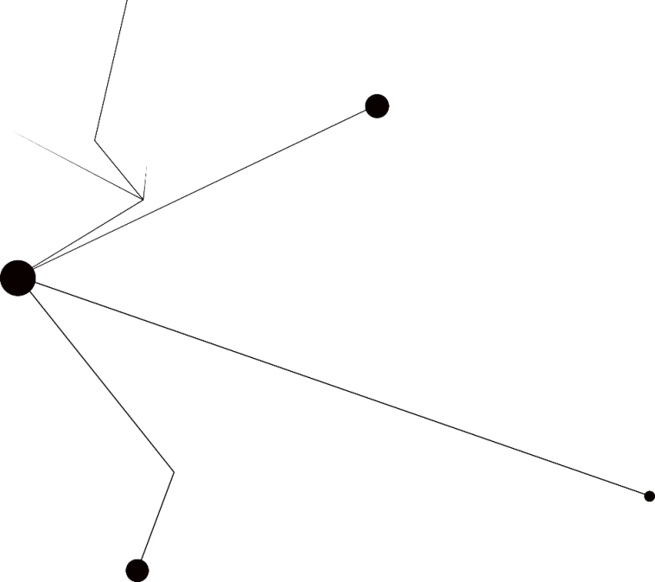
01
小白鸽
Show time
识别效果
识别效果展示

Slide 21
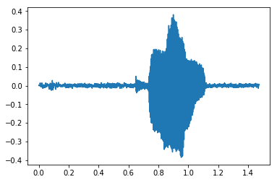
PART 02
语音控制

Slide 22
02
INTRODUTION
Isolated Word Speech Recognition
基本算法
DTW
GMM-HMM
语音输入
特征提取
模式匹配
识别结果
模板库
语音识别流程图

Slide 23
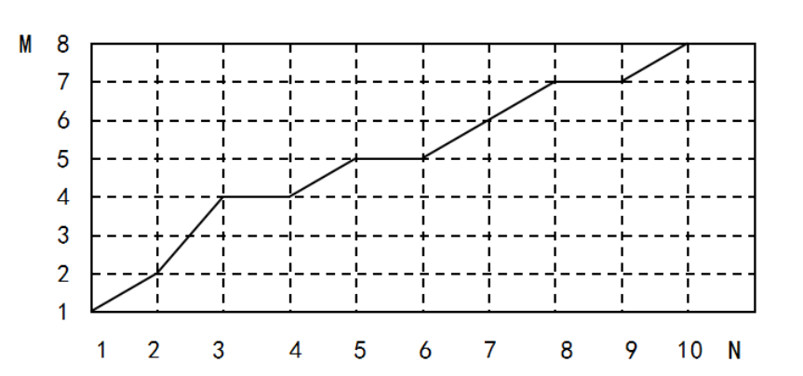
02
DTW
（Dynamic Time Warping，动态时间归整）

Slide 24
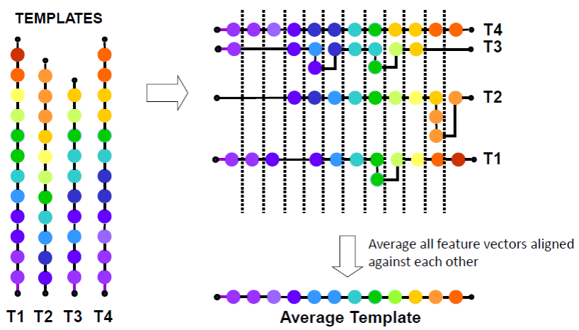
02
DTW

Slide 25
#计算模板
def getTemplate(path, lst, new_path):
y = readWav(path+lst[0])
X = librosa.feature.mfcc(y=y, sr=16000, n_mfcc=20)
result = X.copy()
count = np.ones(X.shape[1], dtype=int)
# 匹配并累加
for i in range(1, len(lst)):
y = readWav(path+lst[i])
Y = librosa.feature.mfcc(y=y, sr=16000, n_mfcc=20)
D, wp = librosa.sequence.dtw(Y, X, step_sizes_sigma=np.array([[1, 0], [1, 1], [1, 2]]))
for j in range(wp.shape[0]):
result[:, wp[i][1]] = result[:, wp[i][1]] + Y[:, wp[i][0]]
count[wp[i][1]] = count[wp[i][1]] + 1
# 平均
for i in range(result.shape[1]):
result[:, i] = result[:, i] / count[i]
np.savetxt(new_path, result, fmt='%.6f',delimiter = ',')
return result
02
DTW
import librosa
import numpy as np
from numpy import inf, argmin
import math
import wave
import pyaudio
from scipy.spatial.distance import pdist
import pylab as pl

Slide 26
02
DTW
def recongnition(wave_data, template_path_lst):
X = librosa.feature.mfcc(y=wave_data, sr=16000, n_mfcc=20)
rst = []
for item in template_path_lst:
Y = np.loadtxt(item, delimiter=",")
D, wp = librosa.sequence.dtw(X, Y, step_sizes_sigma=np.array([[1, 0], [1, 1], [1, 2]]))
rst.append(D[wp[0][0], wp[0][1]])
min_value = min(rst)
return rst.index(min_value)

Slide 27
02
GMM-HMM
HMM主要解决的三个问题。
假设隐藏状态序列和观测状态序列分别使用Z和X表示，则解决的3个问题可表示为:
1.解码问题：已知模型参数和X，估计最可能的Z；维特比算法
2.概率问题：已知模型参数和X，估计X出现的概率；向前-向后算法
3.学习问题：仅给出X和隐藏层个数，估计模型参数。 B-W算法，通常是经过一定数量的训练以后，得到模型，然后解决问题1和2。

Slide 28
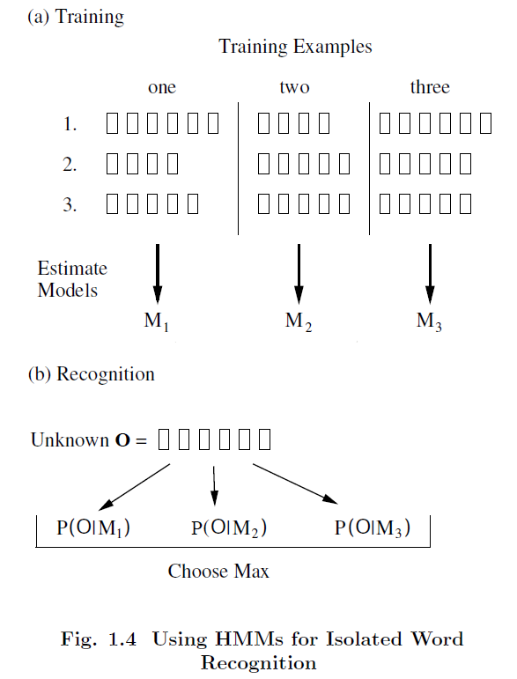
02
GMM-HMM

Slide 29

Show time

Slide 30
Show time
电脑视角
1
人脸识别
路人视角
2
特定人脸识别
3
语音控制

Slide 31

THANKS
第三组

